Slide 1
Side Door
Best Practices

Slide 2
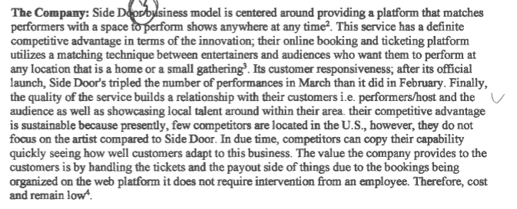
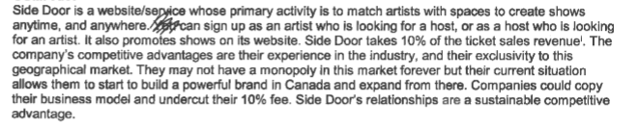
Company – Business Model

Slide 3
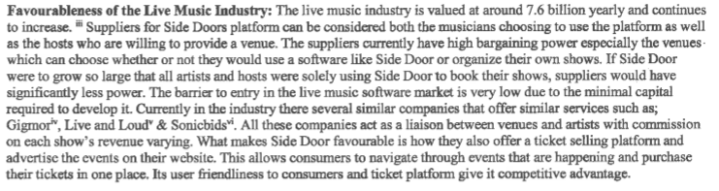
Industry – Live Music

Slide 4
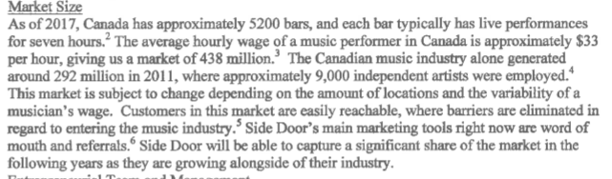
Market Size (note use of citations)

Slide 5
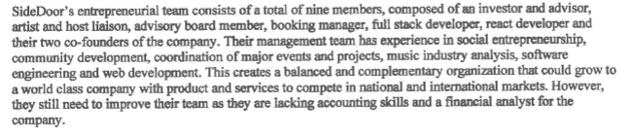
Ent’l team

Slide 6
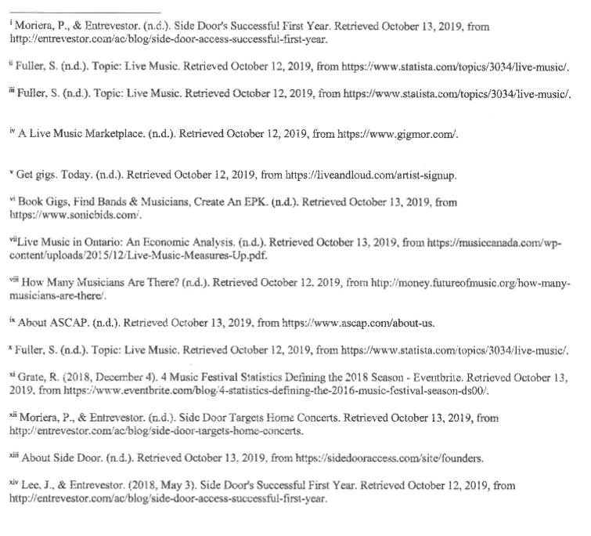
Variety and Breadth of References

